Slide 1



White Hats & Password cracking
Department of Engineering, Computing, and Cybersecurity
Nate Otting
Joshua Mata
Everett Getchell
Professor: Dr. Gonzalo D. Parra

Slide 2


Content
Purpose
Objective
Researched White hats
Password Cracking
Prototyping and Demo
Challenges and Limits
Future Work
Conclusion
Resources and Q & A
Important Dates
Timeline
Management System
Project Milestones

Slide 3

Purpose of the project
Most often we see hackers in movies as morally questionable, but it is important to show that not all hackers are fighting to take our information, but instead to find ways to protect them.
To explore white hat hacking and its essential role in protecting digital systems with ethical hacking practices and professional hacking techniques.
White hat hackers can provide insight into what a company or body needs to do when it comes to hardening systems or networks
https://www.ecpi.edu/blog/how-to-become-a-white-hat-hacker

Slide 4

Objective
To define, explain, and give credit to white hat hackers, for making cyber security more clear, effective, and efficient, and to display how password cracking can be performed more easily than one may think and to provide insights on how to harden passwords and log ins, as well as other alternatives.

Slide 5
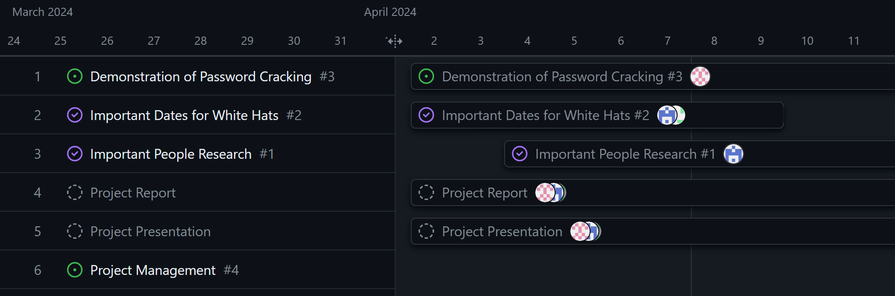
Timeline
We used the GitHub Project Timeline

Slide 6

Management System
We used GitHub Management Board for Our Management System

Slide 7
Project Milestones
Research specific White Hats
Gather Important Dates
Test the capabilities of Password Cracking

Slide 8
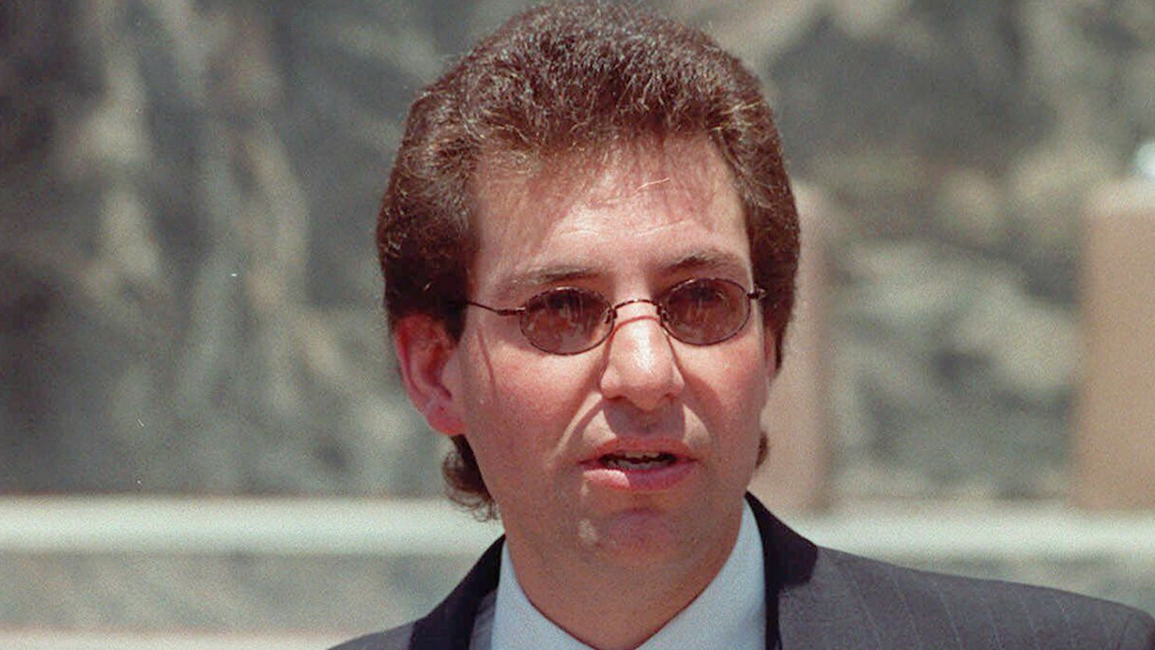

Researched White hats
-Charlie Miller
-HD Moore
-Greg Hoglund
Kevin Mitnick
https://www.cnn.com/2023/07/21/us/computer-hacker-kevin-mitnick-obit/index.html
Tsutomu Shimomura

Slide 9



Important dates for white hats
Late 1960s Beginning of “Tiger Teams”
1995 Kevin Mitnick is captured by Tsutomu Shimomura
1995 John Patrick coins the term “ethical hacking”
1997 Nmap is first released
2008 Ethereal is rewritten and remade into Wireshark v 1.0

Slide 10
Password cracking
This project is intended to demonstrate the use of a program known as Hashcat, which supports various encryption formats and is shown to be quite a useful tool. The tool is command line based only and has no graphical interface.
However, due to some technological limitations, we had to transition to John the Ripper instead alongside PwDump 8.2.

Slide 11
Demonstration of John The ripper using rockyou.txt
Rockyou.txt is a file containing an incredibly large array of passwords that was taken from a data breach of a former MySpace subsidiary company known as RockYou, and many of those sample passwords are examples of what one should NOT use as a password. In the following slides, we will show how JTR is used to extract passwords from hashes of these passwords.

Slide 12
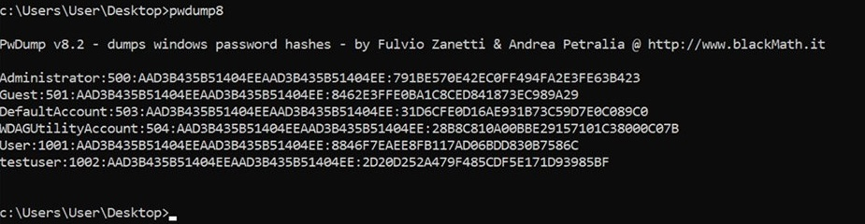
Demonstration USING PWDUMp 8.2
In a virtual Windows machine, we used a command line tool called PwDump 8.2 which uses administrator permission to take the passwords of all users on a device and convert them to hashes.

Slide 13
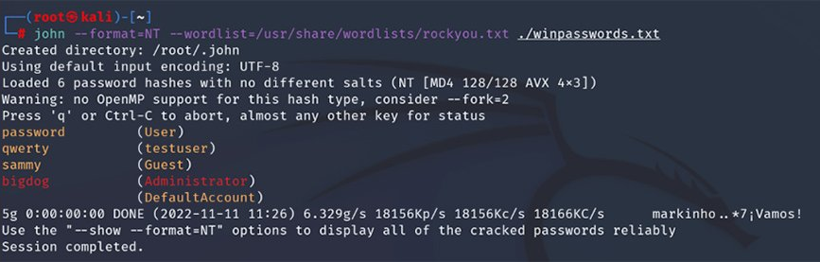
Demonstration continued
In this next section, we take the hashes from the Windows machine, and we store them in an external file on the Kali Linux machine. John the Ripper takes these hashes and compares them against every password option within the rockyou.txt file, and over time reaches a password whose hash matches the list of hashes provided.

Slide 14
Challenges and limitations
One major limitation that was experienced was that the necessary files needed for cracking the passwords was not properly formatted despite our best efforts. The Linux application being used, Hashcat, requires hash tokens to be a specific length, and no matter what format was used, the program could not read the hashes correctly. This is because the Ubuntu password has which begins with $y$ uses a newer encryption algorithm, and Hashcat does not yet support this method which was implemented as of Ubuntu LTS 20.#.#
Another limitation is since the use of this program is solely within two isolated virtual machines, it has caused some issues trying to use, as Hashcat is intended to be used on a host machine.

Slide 15

Further limitations and challenges
Due to the encryption algorithm used by Ubuntu, we had to change from Hashcat to John the Ripper. However, to simplify things, we also had to employ the use of a Windows machine to allow for easier use.

Slide 16
conclusion
The White Hat role is key to ensure the safety and protection are up to standards against adversaries, and thanks to previous and current White Hats who constantly test the boundaries to protect our systems. As well as display password cracking to demonstrate the capabilities of what brute force looks like.
Our project findings and information can be found at: https://github.com/egetche/CompSystemsSecProject

Slide 17
Resources + q&a
Leveraging white hat hackers for Enhanced Cyber Security: Navigating legal challenges. Gowling WLG. (n.d.). https://gowlingwlg.com/en/insights-resources/articles/2023/white-hat-hackers-enhanced-cyber-security/
History of ethical hacking 1960s to today: RedTeam Blogs. RedTeam Hacker Academy. (2023, March 2). https://redteamacademy.com/history-of-ethical-hacking/
What is ethical (white hat) hacking: CEH certification: Imperva. Learning Center. (2023, December 20). https://www.imperva.com/learn/application-security/ethical-hacking/
The history and future of Nmap: Nmap network scanning. The History and Future of Nmap | Nmap Network Scanning. (n.d.). https://nmap.org/book/history-future.html
1.4. A brief history of Wireshark. (n.d.). 1.4 A brief history of Wireshark https://www.wireshark.org/docs/wsug_html_chunked/ChIntroHistory.html
Great rivalries in cybersecurity: Tsutomu Shimomura vs. Kevin Mitnick. Online Masters Degree in Cybersecurity | Guide to Cybersecurity Graduate Programs. (2020, October 9). https://www.cybersecurityeducationguides.org/tsutomu-shimomura-vs-kevin-mitnick/
Kelly Jackson Higgins, E.-C. (2023, December 12). HD Moore unplugged. Dark Reading. https://www.darkreading.com/cyber-risk/hd-moore-unplugged
5 famous White Hat Hackers You should know. King University Online. (2020, February 27). https://online.king.edu/news/5-famous-white-hat-hackers-you-should-know/
U, C. (2021, December 1). The top 10 white hatters. Datatechvibe. https://datatechvibe.com/interviews/the-top-10-white-hatters/
Top 18 famous ethical hackers: The world has ever known. KnowledgeHut. (2024, January 17). https://www.knowledgehut.com/blog/security/most-famous-ethical-hackers
Consulting, M. S. (n.d.). The global ghost team: Expert pentesting services: Mitnick Security. The Global Ghost Team | Expert Pentesting Services | Mitnick Security. https://www.mitnicksecurity.com/global-ghost-team

